Slide 1
Garbage collection in .NET
Comparing with Java, Python and JavaScript approaches
Author: Yuriy Shapovalov

Slide 2
Agenda
Reference counting vs. tracing vs. copying collection
Mark and sweep (and compact) algorithm in CLR
Finalization
Generations
Dispose pattern
Comparison with other platforms

Slide 3

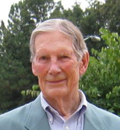
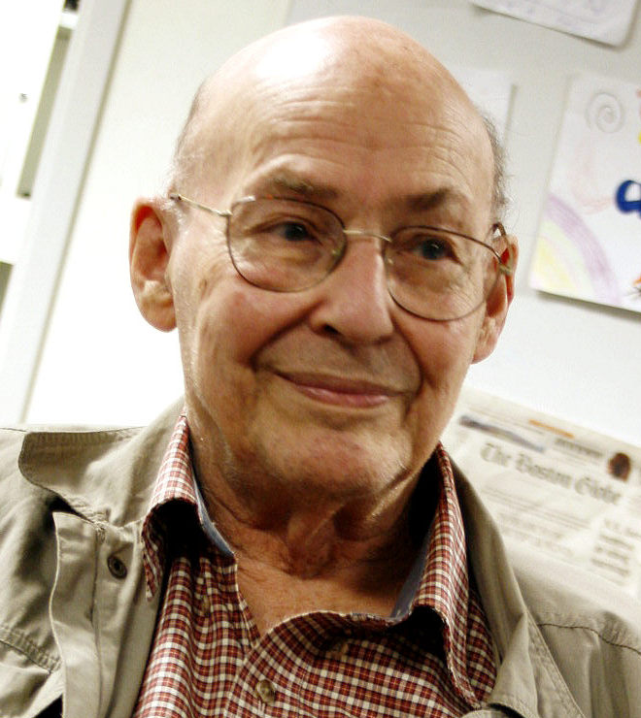
GC Algorithms
Tracing [McCarthy, 1960]
“Mark and Sweep”
Reference Counting [Collins, 1960]
Copying Collection [Minsky, 1963]
“Stop and Copy”

Slide 4
Tracing (mark and sweep)
Stop process
Trace forward from roots
Everything touched in live, all else is garbage
Roots

Slide 5
Tracing (mark and sweep)
Stop process
Trace forward from roots
Everything touched in live, all else is garbage
Roots

Slide 6
Tracing (mark and sweep)
Stop process
Trace forward from roots
Everything touched in live, all else is garbage
Roots

Slide 7
Tracing (mark and sweep)
+ Able to reclaim garbage that contains cyclic references.
+ There is no overhead in storing and manipulating reference counting fields.
+ Objects are not moved during GC – no need to update references to objects
- It many increase heap fragmentation
- It does work proportional to the size of entire heap.
- The program must be halted during garbage collecting.

Slide 8
Reference Counting
Each object has counter of incoming pointers
When counter reaches zero, object can be collected.
root
1
2
0
1
2
0
1
0
2
3
1

Slide 9
Reference Counting
Each object has counter of incoming pointers
When counter reaches zero, object can be collected.
root
1
2
0
1
2
0
1
0
2
3
1

Slide 10
Reference Counting
Each object has counter of incoming pointers
When counter reaches zero, object can be collected.
root
1
1
1
2
0
1
2
1

Slide 11
Reference Counting
Each object has counter of incoming pointers
When counter reaches zero, object can be collected.
root
1
1
1
2
1
1

Slide 12
Reference Counting
Each object has counter of incoming pointers
When counter reaches zero, object can be collected.
- Have a problem with cyclic dependencies
root
1
1
1
1
1
2
1
1
1
1

Slide 13
Reference Counting
+ Simple. Garbage is easily identified.
+ Easy to implement.
+ Immediate reclamation of storage.
- The overhead of incrementing and decrementing the reference count each time
- Extra space for counter field in each object.
- It may increase heap fragmentation
- Does not detect garbage with cyclic references.

Slide 14
Copying collections
Memory is organized into two areas
old space: used for allocation
new space: used as a reserve for GC
GC starts when the old space is full.
Copies all reachable objects from old space to new.
Reverse roles of the old and new spaces.
old space
new space
root
a
b
c
d

Slide 15
Copying collections
Memory is organized into two areas
old space: used for allocation
new space: used as a reserve for GC
GC starts when the old space is full.
Copies all reachable objects from old space to new.
Reverse roles of the old and new spaces.
old space
new space
root
a
b
c
d

Slide 16
Copying collections
Memory is organized into two areas
old space: used for allocation
new space: used as a reserve for GC
GC starts when the old space is full.
Copies all reachable objects from old space to new.
Reverse roles of the old and new spaces.
old space
new space
b
d
root
a
c

Slide 17
Copying collections
Memory is organized into two areas
old space: used for allocation
new space: used as a reserve for GC
GC starts when the old space is full.
Copies all reachable objects from old space to new.
Reverse roles of the old and new spaces.
new space
old space
root
a
c

Slide 18
Copying collections
+ Only one pass through the data is required
+ It de-fragment the heap
+ Able to reclaim garbage with cyclic references.
+ No overhead with reference storage and manipulating.
- Twice as much memory is needed for a given amount of heap space
- Objects are moved in memory during garbage collection (references need to be updated)
- The program must be halted during garbage collecting.

Slide 19
Comparison
 | Tracing | Reference counting | Copying collections
Collection style | batch | incremental | copy
Pause Times | long | short | long
Real Time | no | yes | no
Delayed Reclamation | yes | no | no
Cost per mutation | none | high | low
Collects cycles | yes | no | yes

Slide 20
Mark and Sweep IN CLR
Roots
Processes
global
stack
CPU registers
stack
stack

Slide 21
Mark and Sweep IN CLR
Roots
Processes
global
stack
CPU registers
stack
stack

Slide 22
Mark and Sweep in CLR
Roots
Processes
global
stack
CPU registers
stack
stack

Slide 23
Finalization
Each type which contains unmanaged resources, like file, network connection or mutex, should implement finalization.
public class Fin
{
public FileStream fs;
Fin()
{
fs = new FileStream("text.txt", FileMode. Create);
}
~Fin()
{
fs.Close();
}
}

Slide 24
Finalization
Finalization can be called in following cases
Generation 0 is full
The most common way to call Finalize().
Explicit call static method GC.Collect()
Although Microsoft does not recommend to do that, sometime it make sense to force collecting.
Unload application domain.
CLR treat that application has no roots anymore.
Closing CLR
CLR tries to call Finalize() for each object in managed heap

Slide 25
Finalization
a
b
c
d
e
f
Finalization queue
g
h
i
F-reachable queue

Slide 26
Finalization
c
d
e
a
h
b
c
d
e
f
Finalization queue
g
h
i
F-reachable queue

Slide 27
Finalization
c
d
e
a
h
b
c
d
e
f
Finalization queue
g
h
i
F-reachable queue

Slide 28
Finalization
d
a
h
b
c
c
e
d
e
f
Finalization queue
h
F-reachable queue

Slide 29
Finalization
d
a
h
b
f
e
d
e
Finalization queue
h
F-reachable queue

Slide 30
Finalization
d
a
h
b
f
d
Finalization queue
h
F-reachable queue

Slide 31
Finalization
Finalize is calling when object is not using.
But, in Finalize() method, we can save reference to this object to some global variable, and use it in future.
~Fin()
{
someGlobalVar = this;
}

Slide 32
Generations
Younger objects dies faster
Older objects live longer
Garbage collection works faster for part of the heap, than for whole heap.
GLR has 3 generations:
0 – for new objects
1 – for old objects
2 – for the oldest

Slide 33
Generations
a
b
c
d
e
0
a
b
c
d
e
0
a
b
d
1
0

Slide 34
Generations
a
b
d
f
g
h
i
j
k
1
0
a
b
d
f
g
h
i
j
k
1
0
a
d
g
i
2
1
0

Slide 35
Large Object Heap (LOH)
CLR has special heap for large objects ( < 85kb )
LOH does nod defragmented during the GC.
It will require too much processor time
All objects in LOH threats as 2 generation

Slide 36
Dispose Pattern
Object can have Managed and Unmanaged resources.
Managed resources can be handled by GC.
Unmanaged resources should be closed by developer.
public void WriteToFile(string s)
{
TextWriter tw = new StreamWriter("text.txt", true);
tw.Write("new text");
TextWriter tw2 = new StreamWriter("text.txt", true); //???
}

Slide 37
Dispose Pattern
Class contained managed and unmanaged resources implements interface IDisposable.
Boolean parameter disposing is:
true – call from Dispose() method.
false – call from Finalize() method.
// For not-sealed classes
protected virtual void Dispose(bool disposing) { }
// For sealed classes
private void Dispose(bool disposing) { }

Slide 38
Dispose Pattern
Firstly we call Dispose(true)
Then, we should call GC.SuppressFinalize(this), which prevent finalization call.
GC.SuppressFinalize() should be after, to not block finalization, if Dispose(true) will throw exception.
public void Dispose()
{
Dispose(true);
GC.SuppressFinalize(this);
}

Slide 39
Dispose Pattern
void Dispose(bool disposing)
{
if (disposing)
{
// Managed resources
}
// Unmanaged resources
}
Class might have finalizator and call Dispose(false) from there.
~Fin()
{
Dispose(false);
}

Slide 40
Dispose Pattern
You can use “using” statement only with types which implements IDisposable.
using(TextWriter tw = new StreamWriter("text.txt", true))
{
tw.Write("new text");
}

Slide 41
GC in Java
Mark-Sweep-Compcat
Java specification does not declare GC algorithm
Different JVM has different GC implementations
In Oracle JVM implemented 6 algorithms, which can be chosen by compilation parameter.
finalize() might be affected by exception.
4 generation (Young, Survivor, Old, Permanent)

Slide 42
GC in Python
Generational Reference Counting
The same as .NET CLR, has 3 generations.
GC can be disabled, and programmer can switch it off.
Using reference counting with specific procedure of cycles handling.

Slide 43
GC in JavaScript (V8 as example)
Non-generational Mark and Sweep
Every objects in scope is called a "scavenger". GC create a "scav" list of this object.
When GC runs, it mark every object, variable, string, etc.
Then, it clear the mark from objects in "scav" list, and the transitive closures of scavenger references.
At this point we know that all the memory still marked is allocated memory which cannot be reached by any path from any in-scope variable.

Slide 44
GC in JavaScript (SpiderMonkey)
Incremental (Tracing) Mark and Sweep
Allows eliminate downtimes during garbage collecting.
GC usually happen every 5 seconds
"Incremental garbage collection fixes the problem by dividing the work of a GC into smaller pieces. Rather than do a 500 millisecond garbage collection, an incremental collector might divide the work into fifty slices, each taking 10ms to complete. In between the slices, Firefox is free to respond to mouse clicks and draw animations.“
http://blog.mozilla.org/javascript/2012/08/28/incremental-gc-in-firefox-16/

Slide 45
Summary
There is many algorithms and approaches for garbage collecting.
All high-performance garbage collectors are hybrids.
Developer still responsible for correct working with memory.
There is no ideal and good-for-all-cases approaches.

Slide 46
Questions

